Slide 1
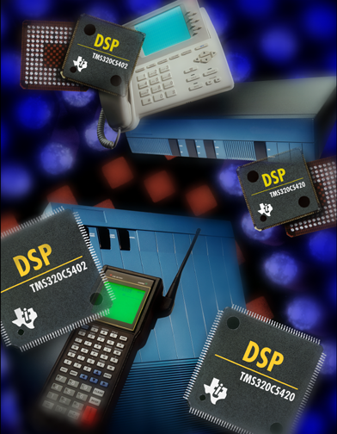
TMS320 One-Day DSP Workshop
For Arizona State University
Texas Instruments
C55x

Slide 2
Programming With Ease
Chapter 3
C55x One-Day Workshop
T TO
Technical Training
Organization
Copyright © 2003 Texas Instruments. All rights reserved.

Slide 3
Agenda
Peripherals - the I/O Gateway
McBSP, Codec
DMA
Using CSL to Program Peripherals
C55x C Compiler Performance
Using DSP/BIOS
BIOS Thread Types
Real-time Analysis Tools
Lab - Using C Compiler/Optimizer, CSL
T TO
Technical Training
Organization
Notes:
Programming with ease really means “abstracting the user from the details of the architecture”. So, we decided to focus on three main areas: peripherals using CSL, using the C compiler, and how DSP/BIOS and RTA can assist users in debugging/designing their application.

Slide 4


Audio Application
McBSP2
DMA
CPU
gBufferRcv
Flash LED
P
i
n
g
0
AIC23
Rcv
RCVCHAN
ADC
P
o
n
g
Hi-pass
Filter
-or-
Copy
3
gBufferXmt
P
i
n
g
AIC23
Xmt
XMTCHAN
DAC
P
o
n
g
Load
1
McBSP receives serial data from AIC23
DMA copies data to/from buffers
T TO
Technical Training
Organization
Notes:
The focus here is on the role of the McBSP and DMA in the system and how they interact with each other.

Slide 5
McBSP ↔ Codec Interface
McBSP2
AIC23
DMA
DRR
ADC
gain
DXR
DAC
gain
CLKR/X
PLD
BITCLK
FSR/X
FS
AIC23 exchanges data serially with McBSP2 in stereo format (L,R,L..)
McBSP receives/transmits 16-bit data from codec via DRR/DXR
McBSP can be set up using several options:
Frame length (1-128)
Word length (8/12/16/20/24/32)
Companding (µlaw, A-law)?
CLK (input, output, polarity)
FS (input, output, polarity)
CPU Interrupt or DMA Sync?
T TO
What else can the McBSP do?
Technical Training
Organization
Notes:
The diagram above is kind of simplified because it leaves out the details of the PLD on the DSK. The PLD actually is programmed by the CPU using McBSP0 and the clock and frame sync on BOTH the DSP and AIC23 are INPUTS - the PLD generates all signal timing to the codec and DSP. But, because this is a one-day class, we felt that we didn’t want to go into that depth - however, you might get a question about this.
This is an intro to how the McBSP operates - and not intended to cover all the details. It is a highly flexible peripheral with MANY bits to program depending on what the user wants. That’s why we show the 6 bullets at the bottom. The other important item to note is that the DMA is handling the transfer of the data to/from the serial port and memory.

Slide 6
Other McBSP Capabilities
Supports direct interface to: T1/E1 framers, MVIP/ST-Bus,
IOM-2, AC’97 (multi-phase, CLKS), IIS, SPI
Automatic µ-law/A-law companding (on rcv/xmt)
Internal clk/frame generation using Sample Rate Generator (SRGR)
Programmable polarity of clock/frame
Digital Loopback (DLB): internally hooks xmt to rcv for debug
CPU interrupts occur when: (R/XRDY=1, new FS, error)
Can delay first data bit after FS by 0, 1, 2 clk cycles (required by
some serial protocols)
All typical errors/status are reported
McBSP pins can be configured as general-purpose I/O if desired
How does the DMA work?
T TO
All pins, registers and full explanations of these capabilities
can be found in the Peripheral User’s Guide
Technical Training
Organization
Notes:
This slide is intended to “point” to other capabilities that are available on the McBSP. Each user will be looking for something different, so these statements will help them understand other features that might meet their needs. If a question comes up on any of these items, either answer it (if you know) or peruse the peripherals document and find the answer during a break.
All of the registers, pins and full explanations are available in the peripherals document.
There is no time in the workshop to explore any of these capabilities - the point is to show off a few of the options users have in case they are interested. App notes and specs are available that explain each in more detail.

Slide 7
Direct Memory Access (DMA)
Performs data transfers without CPU intervention
SOURCE
DEST
SRC addr
Element 1
Frame 1
DST addr
Element 2
Frame 2
Element 3
Frame 3
Element: basic unit of transfer (1, 2, or 4 bytes)
Frame: a group of 1 to 64K elements
Block: a group of 1 to 64K frames
Max Performance: 2 16-bit transfers (R/W) per cycle
Priority
CPU has fixed priority over DMA
DMA CH’s can be placed in hi/low rotating queues
Transfers can be sync’d to 20 different events (eg. DRR ready)
Flexible indexing modes (+/-, elem/frm index) support channel sorting
Autoinit: automatically sets up channel for the next transfer
T TO
What affects the DMA’s throughput?
Technical Training
Organization
Notes:
FAQ - how do you get the max throughput of 2 16-bit xfrs per cycle? The DMA contains a FIFO that allows reads to get ahead of writes. Also, there are 4 resources that the DMA can use: SARAM, DARAM, Periph, EMIF. You have to use two DMA channels simultaneously that are reading/writing from different resources. For example, DMA Ch1 is transferring from DARAM to EMIF and Ch2 is transferring from SARAM to the DXR (periph) AND there can’t be any conflicts with the CPU (which has the priority) AND, there can’t be a higher priority channel running. Wow - lots of limitations…but it IS possible. The other fact you need to know is how the FIFO works. For example:
1: R0
2: R1
3: R2/W0
4: R3/W1
This is the sequence. On the 3rd time interval, the DMA is reading one data item (R2) and writing the first one (W0). This is a 16-bit read/write in the same cycle.
Why does the CPU have fixed priority over the DMA? Because it was determined that if the CPU was running an important ISR (algorithm..filter..etc), it should be able to “trump” the DMA and get what it needs first. Not a big deal - the user just needs to know.

Slide 8
DMA Throughput
DMA throughput is affected by the following:
1
CPU has FIXED priority over the DMA
- Affects access to: Peripherals, EMIF, SARAM, DARAM
2
Can place DMA channel and EHPI in high or low round robin
- One element is transferred per channel in each queue
- Low serviced when high xfr complete or waiting for sync event
High
Low
Ch-3
Ch-0
Ch-5
Ch-1
Ch-2
Ch-4
3
Can set a channel to burst 4 32-bit elements per transfer
creating a “higher priority” within a single queue
T TO
We’re using indexing to channel sort in the lab…
Technical Training
Organization
Notes:
When in a high or low priority round robin, one element per channel is transferred. For example, if the above example is using the high priority round robin, one element from Ch0 is transferred, then the next element of Ch2 is transferred, then the next element of Ch3 and this repeats. Channels are skipped once a frame/block transfer is complete. All high priority transfers must complete before servicing the low priority channels.
Currently the HPI interface cannot program the DMA channel registers (although, it would be great if it did).
If you want to create a “mini priority” within either the hi or low queue, you can by turning on the burst capability in the DMA. Burst will transfer 4 32-bit elements (or 8 16-bit elements) per time before handing the token to the next channel.

Slide 9
DMA Channel Sorting
L0
McBSP
L1
ADC
DMA
DRR
…
L0
R0
L1
R1
R0
Event
R1
…
ADC outputs interleaved (L, R) stereo data
When DRR is ready to be transferred, McBSP sends
a “receive” event (REVT) to the DMA
DMA uses indexing (element and frame) to sort the
stereo stream into L and R buffers
Now, a standard filter can be used to process the data
How do we easily program the peripheral registers?
T TO
Technical Training
Organization
Notes:
Channel sorting is a very useful feature in applications, whether it’s 2 channels or 32 channels. In our code, the codec transfers the left data, then the right, then left. If we plan to filter this music, we must separate the L and R channels and place them in contiguous memory locations prior to filtering them. The DMA uses indexing (element and frame) to sort the stereo stream. For example, if you have 16 elements in each buffer, after the first element is transferred, the destination address is moved to the top of the R buffer. After this data is transferred, frame index is used to move the dest address to the 2nd location in L buffer and so on. So, you’d have 2 elements in each frame (L and R) and 16 frames. Easy. Then, when the block is done, the CPU filters each buffer separately.

Slide 10
CSL – An Easier Way to Manage Peripherals
Chip Support Library (CSL) consists of:
Data Structures (myConfig, etc.)
- values to put in the registers
Functions (DMA_config, etc.)
- allow us to initialize and manage the resources
Macros (DMA_OPT_RMK(), etc.)
- provides hi-level access to low-level operations
Providing two essential capabilities:
Peripheral Programming
Resource Management (keeps track of used resources)
DMA_Config myConfig = {
SRC_ADDR,
DEST_ADDR,
ELEM_COUNT,
AUTOINIT_ON,
… }
DMA Channels Regs
Source
Destination
Elem Count
Frame Count
Elem Index
Frame Index
T TO
Programmatic method is shown…can also use the CSL GUI…
Technical Training
Organization
Notes:
CSL can be used to program the peripherals. You still need to know what each bit does, but it is much easier to program the bits with symbols (like ACTIVE or ON) vs. a 1 or 0. You can either use CSL API calls (like open and config) or you can use the CSL GUI to do it for you. Either way is ok - and much simpler than programming bits via assembly.
CSL has three parts: data structures (like myConfig above), functions such as DMA_config and Macros to assist in programming individual bits in a register. CSL not only programs the peripherals, but can also keep track of resource usage for you.

Slide 11
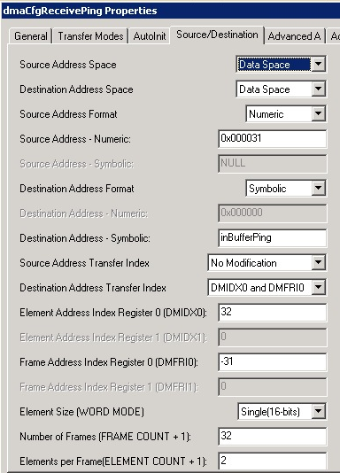
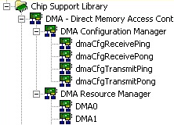
Chip Support Library (CSL) GUI Interface
Open .cdb file:
Create a new DMA configuration
Select the options
Use Resource Manager to
apply configuration to the
proper resource (e.g. DMA0)
T TO
CSL supports the chip level …BSL supports the board-level…
Technical Training
Organization
Notes:
CSL is a two step process: (1) first, you need to set up a configuration for the DMA channel such as dmaCfgReceivePong as shown above by selecting the options in the GUI interface. (2) Then, you specify WHICH resource you want it applied to (e.g. DMA0, DMA1).

Slide 12
C55x DSK Board Support Library
Board Support Library (BSL)
Board-level routines supporting DSK-specific hardware
Higher level of abstraction than CSL
BSL functions make use of CSL
codec
LEDs
switches
Chip Support Library (CSL)
Low-level routines supporting on-chip peripherals
McBSP
DMA
Idle Modes
EMIF
Timer
etc.
TI DSP
‘C5510
T TO
What other peripherals does the C5510 have?
Technical Training
Organization
Notes:
BSL contains macros for programming devices on a board - e.g. the AIC23 codec on the C5510 DSK. These are Board Specific - so they may or may not help the user depending on what they’re doing. If they’re using the DSK, they are a HUGE help. If they are using some other codec on the board, they’ll have to configure some of these options on their own.
In this workshop, we use BSL to program the AIC23 codec, LEDs and manage the switches.

Slide 13
‘C5510 Peripheral Overview
Host
‘C5510
MCBSP
EHPI
55xx
CPU
GPIO
DMA
Timers
External
Memory
EMIF
Power
Boot
Cache
EHPI
- 16-bit host access to memory
DMA
- 6 Channels
EMIF
- Access to EPROM, SRAM,
SBSRAM, SDRAM
BOOT Loader
- From external mem, Host, McBSP
3 Multi-Channel Buffered SPs
- High speed sync serial comm
General Purpose I/O
- 8-bit i/o port
Timer/Counters
- Two 20-bit timer/counters
Power-Down Modes
Instruction Cache (24K bytes)
T TO
How does the bootloader work?
Technical Training
Organization
Notes:
This is simply a 10K foot level view of the peripherals. Let the students know that we will cover how each of these peripherals work and how to setup basic tasks within each.
There is no time to cover every detail and we’ve already gone thru some of the details of the EMIF, DMA, Power-down modes and McBSP. We also cover the boot loader on the next slide. So, EHPI, Timers and cache really don’t get much coverage, but it’s a one-day workshop.
FAQ - the cache is INSTRUCTION only - no data cache. It is comprised of a 16K byte 2-way cache and 2 4K 1-way (ramset) caches. Basically, you just turn on the 2-way cache and let it run. The 1-way cache can be used for ISRs that aren’t in internal memory. There is only ONE tag for the ramset and they are NOT updated on misses.

Slide 14
Software Boot Loader - Overview
BOOTM pins (sampled at reset)
determine type of boot:
Boot up to 64Kx16 of the 5510’s
internal memory
Boot performed by ROM-coded
boot routines during reset
Can bootload your own boot
routine if 64K is limiting
BOOTM[3:0]
No boot (begin execution
at reset vector)
EHPI
Parallel EMIF (external)
Serial
Internal ROM
Boot loader
0xFF8000
Sine Tbl
TI test code
vector tbl
0xFFFF00
Refer to SPRA763 for all
C55x bootloader details
Notes:
The external pins - BOOTM[3:0] - drive the boot load sequence. 4 bits selects 8 options (none-2, parallel: 8/16/32-bit, EHPI, std serial: 8, 16-bit, EEPROM: 16/24-bit - 10 options, six are reserved).
The size is limited to 64K WORDS because you can only specify a 16 bits size, which is in words. Also, the destination address for the external and serial boot is specified in two 16-bit locations (as shown on the next slide), but only the appropriate # of bits are used to specify the lower memory locations in internal memory. This allows the user to specify the MDP as well as the lower 16 bits in the DEST address.
If you desire to boot into external memory or more than 64K words, simply boot a small boot-load routine which sets up the DMA to copy from anywhere to anywhere you like.

Slide 15
Agenda
Peripherals - the I/O Gateway
McBSP, Codec
DMA
Using CSL to Program Peripherals
C55x C Compiler Performance
Using DSP/BIOS
BIOS Thread Types
Real-time Analysis Tools
Lab - Using C Compiler/Optimizer, CSL
T TO
Technical Training
Organization

Slide 16

C55x C Performance
C55x architecture is optimized for C:
9 addr regs, 4 temp regs, 2 ALUs…lots of registers for C to use
with minimal restrictions
Flexible addressing modes…C can efficiently access stack vars
Unified memory space…C can use any memory for data/prog
C compiler offers various optimization methods:
4 Optimization levels
Intrinsic support (C’s access to ASM)
Takes full advantage of efficient
loops (RPT, RPTBLOCAL) and
parallel instructions
Excellent math support from C
Let’s look at an example of how the compiler optimizes DSP C code…
T TO
Technical Training
Organization
Notes:
The key for any compiler to be “optimized for C” is flexibility in address modes and the lack of restrictions on what the compiler can do - e.g. the unified memory map. Also, it likes LOTs of registers which the C55x has - especially with the addition of another ALU and the temp registers.
Intrinsics are a way for C code to gain access to assembly instructions directly. The advantage of using intrinsics is that the compiler knows what they are and they also use C variable types. Optimization is also possible because it still is C code…but specific to the C55x.
The compiler produces decent results…but like any compiler, it can get better with more input by the user. Compiler’s are conservative by nature, but the compiler also offers MANY switches and pragmas that allow the user to provide more information about the code to allow the compiler to perform better optimizations.

Slide 17
Impressive DSP-Math Performance
Typically, compilers are good at optimizing O/S-type code (bit
testing, branching, etc), but not DSP math-intensive routines.
The C55x compiler, however, optimizes the generic filter code
below to near hand-coded ASM performance levels:
for (i = 0; i < blksize; i+=2)
{
temp1 = 0;
temp2 = 0;
for (j=0;j<taps;j++)
{
temp1 = _smac(temp1,data[i+j],coeffs[j]);
temp2 = _smac(temp2,data[i+j+1],coeffs[j]);
}
results[i] = extract_h(temp1);
results[i+1] = extract_h(temp2);
}
Notice use of _smac intrinsic
Build options: -o2, no debug
(-mb, i.e. coeffs on chip)
Compiler generates:
RPTBLOCAL for outer loop
RPT for inner loop
Parallel instructions…
…and a dual-MAC:
AMAR *AR2+ || RPT CSR
MAC *AR2+, coef(*CDP+), AC1
:: MAC *AR3+, coef(*CDP+), AC0
T TO
Technical Training
Organization

Slide 18
Agenda
Peripherals - the I/O Gateway
McBSP, Codec
DMA
Using CSL to Program Peripherals
C55x C Compiler Performance
Using DSP/BIOS
BIOS Thread Types
Real-time Analysis Tools
Lab - Using C Compiler/Optimizer, CSL
T TO
Technical Training
Organization

Slide 19
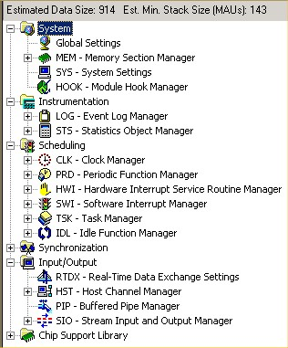
DSP BIOS Consists Of:
Real-time analysis tools
  Allows application to run
  uninterrupted while displaying
  debug data
Real-time scheduler
  Preemptive thread mgmt
  kernel
Real-time I/O
  Allows two-way communication
  between threads or between
  target and PC host.
T TO
Let’s take a look at the different thread types…
Technical Training
Organization
Notes:
cover the most used elements: CLK, MEM, HWI, SWI … whatever you consider most important for the group

Slide 20
DSP/BIOS Thread Types
HWI
Hardware Interrupts
Used to implement 'urgent' part of real-time event
Triggered by hardware interrupt
HWI priorities set by hardware
SWI
Software Interrupts
Use SWI to perform HWI 'follow-up' activity
SWI's are 'posted' by software
Multiple SWIs at each of 15 priority levels
Priority
TSK
Tasks
Use TSK to run different programs concurrently under separate contexts
TSK's enabled by posting 'semaphore‘ (a signal)
IDL
Background
Multiple IDL functions
Runs as an infinite loop, like traditional while loop
All BIOS data transfers to host occur here
T TO
What real-time tools can help us analyze our system?
Technical Training
Organization
Notes:
SWIs and TSKs do basically the same thing but use different resources. If the student is an O/S person, they are familiar with TSKs - create them, use them, delete them - and they have their own stack. If the student is more of an HWI person, SWIs will make more sense. TSKs run in a loop…go…then wait for a signal (semaphore)…then go again…then wait for a signal…etc. SWIs start running and continue running until the end…then STOP and must be posted again (similar to a hardware interrupt).
When the processor is NOT doing an HWI, TSK or SWI, then it falls back to BIOS IDL. BIOS IDL is where all RTA information is sent to the host PC.

Slide 21
Priority Based Thread Scheduling
HWI 2
HWI 1
SWI 3
SWI 2
SWI 1
MAIN
IDLE
post3
rtn
SWI_post(&swi2);
(highest)
post2
rtn
post1
rtn
int2
rtn
rtn
rtn
int1
(lowest)
User sets the priority...BIOS does the scheduling
T TO
How do you create a SWI and set priorities ?
Technical Training
Organization
Notes:
Here’s how to explain this foil.
First while we have HWI1 and 2 at the top of the screen, you won’t actually see this in the real-time analysis tool. All hardware interrupts will be grouped in “other threads”.
Start at main on the bottom left. Main runs until a return were the only process running is BIOS idle. Hardware interrupt 1 occurs and starts running. It posts software interrupt 2. SWI 2 can run until HWI 1 completes. Until it does SWI 2 is pending. When HWI1 completes SWI2 begins until HWI2 occurs. HWI2 posts SWI3 three which cannot run until HWI2 completes. When HWI2 completes, the highest priority pending interrupt will run. In this case that’s SWI3. SWI 3 posts SWI1 during its run. When SWI 3 completes, the highest priority pending interrupt is allowed to run ... which is SWI2. When SWI 2 completes there are no other pending interrupts so we return to the idle process.
The priority of hardware interrupts is hard wired into the device. The user can determine the priority of software interrupts.

Slide 22
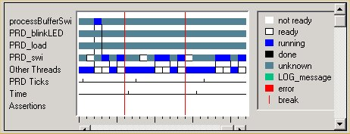
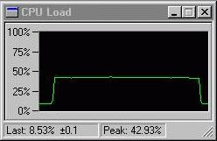
Built-in Real-Time Analysis Tools
What is “real time” ?
Gather data on target (3-10 CPU cycles)
Send data during BIOS IDL (100s of cycles)
Format data on host (1000s of cycles)
Data gathering does NOT stop target CPU
Execution Graph
Software logic analyzer
Debug event timing
and priority
CPU Load Graph
Analyze time NOT
spent in BIOS IDL
T TO
Technical Training
Organization
Notes:
These tools are built into BIOS and require little or no coding effort by the user.

Slide 23
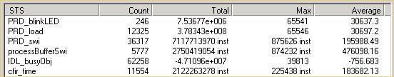
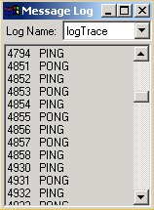
Built-in Real-Time Analysis Tools
Statistics View
Profile routines w/o
halting the CPU
Message LOG
Send debug msgs to host
Doesn’t halt the DSP
Much more efficient than
traditional printf()
LOG_printf (&logTrace, “PING”);
T TO
Technical Training
Organization

Slide 24
Hex Conversion Utility (hex55)
hex.cmd
app.hex
(hex)
app.out
hex55
ASCII-hex
Tektronix
Intel MCS-86
Motorola-S
TI-tagged
Converts a “.out” file into one of several hex formats
suitable for programming.
Use: hex55 filename.cmd
Command file specifies options and filenames…
What does hex.cmd look like?
T TO
Technical Training
Organization

Slide 25
Hex.cmd
Release\dsk_app2.out /* Input COFF file */
-m2 /* Select Motorola-S1 */
-boot /* Put all initialized sections in image */
-map dsk_app2_hex.map /* Name hex utility map file */
-parallel16 /* Set Flash system memory width */
-v5510:2 /* Set processor type */
-o dsk_app2.hex /* hex output file */
ROMS /* Specify origin/length of FLASH */
{
PAGE 0 : ROM : o=0x400000, l=0x80000
}
T TO
How can we program the hex file into flash?
Technical Training
Organization

Slide 26
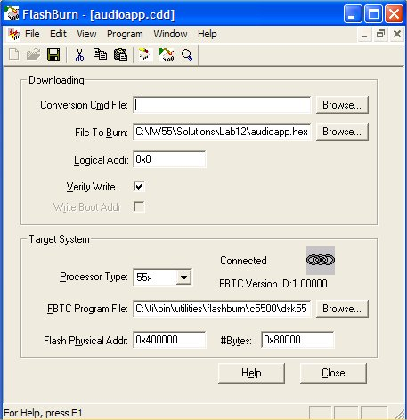
Using FlashBurn
CCS plug-in that programs
the flash via JTAG
Requires a hex version of
the executable .out
Transfers a small, FLASH-
specific routine to the DSP
which communicates to
the host
T TO
Technical Training
Organization

Slide 27
McBSP Block Diagram
Full duplex direct interface to codecs and other serial devices
Max bit rate: 1/2 CPU Clock Rate
McBSP
CPU
RINT
P
e
r
I
p
h
B
u
s
BDR
RSR
RBR
DRR
BDX
XSR
DXR
DMA
BCLKR
XINT
BCLKX
Clock
&
Frame
Control
Event
BFSR
Multi-Channel
Control
BFSX
BCLKS
Word length: 8-, 12-, 16-, 20-, 24-, 32-bit
Frame length (between FS): 1-128 words
Let’s see an example...
Notes:
There are actually two DRR and 2 DXR registers, each 16-bits wide. But I show them as only ONE register here that can go from 8 to 32 bits. They get the concept, but when they see the documentation, they’ll see two separate 16-bit registers. Not a big deal.

Slide 28
The “Mc” - Multi-Channel - BSP
“Mc”
Ch0-0
Frame
TDM Bit Stream
Ch0-1
M
c
B
S
P
Transmit
&
Receive
only selected
Channels
C
O
D
E
C
0
Ch0
Ch1
...
Ch31
Ch5-0
1
Ch0
Ch1
...
Ch31
Ch5-1
Ch27-0
Ch27-1
Allows multiple channels (words) to be independently selected for transmit
and receive. (Ex: only enable Ch0, 5, 27 for receive, then process via CPU)
The McBSP keeps time sync with all channels, but only “listens” or “talks”
if the specific channel is enabled - reduces processing/bus overhead.
Multi-channel mode controlled primarily via two registers:
Multi-channel Control Reg
Rec/Xmt Channel Enable Reg
MCR
R/XCER
- enables Mc-mode
- enable/disable channels
Up to 128 channels can be enabled at one time.
Notes:
The top bullet actually describes two things: (1) the ability of the McBSP to selectively LISTEN/TALK during specific channel times; (2) the ability of the DMA to sort each channel into the appropriate spot thereby grouping the channels together - this is called “channel sorting”.
If only a single channel is being used, there is no need to enable multi-channel mode.

Slide 29
DMA Registers, Resources
DMA “Ports”
DMA Channels 0-5
Read
Bus
32
DARAM
Source
Destination
32
Elem Index
Frame Index
32
SARAM
Elem Count
Frame Count
16-bit FIFO
32
EMIF
Control
Status
32
16
Peripherals
EHPI
Auxiliary
Channel
Write
Bus
16
EHPI
Each CHx has: 2 32-bit buses (R/W) + 16-bit FIFO + 8 DMA regs shown
DMA Channels 0-5 have access to all ports except EHPI port
EHPI Auxiliary Channel has access to all ports except Peripherals port
Notes:
Ok a “port” is really a bus that goes from the resource (e.g. a DARAM) to the DMA bus. So, there are 3 32-bit “port” buses (to the DARAM, SARAM and EMIF) and two 16-bit “port” buses to RHEA and the EHPI. All this means is that the DMA can grab 32-bits from (eg. the DARAM) quicker than with a 16-bit port thus allowing the CPU to get in quicker if needed. Once the data is on the “port” bus, it uses the 32-bit READ bus to read it and the 32-bit WRITE bus to write it. The FIFO is stuck in the middle of these buses to buffer the reads from the writes (I.e. you can get ahead by the depth of the FIFO if the write resource “port” is busy). So, when we say “DMA bus”, we’re talking about the 32-bit buses (read and write for each channel) Read FROM the port bus and Write TO the destination port bus. When we say “port” we’re talking about the 32-bit or 16-bit RESOURCE bus that is connected to the 32-bit DMA buses.
Ah, what a mouth full. My 7-yr old could have designed a more intuitive DMA…
Max Through-put is achieved by using 2 different channels (x and y) AND CHx must use 2 different ports and CHy must use different ports (which are different than CHx’s).
Each Channel contains the following buses (24-bit read addr, 24-bit write addr, 32-bit data read, 32-bit data write). That’s 24 buses for 6 channels. Each chanel also contains a 16-bit FIFO. However, you read INTO the 16-bit FIFO and write FROM the FIFO. So, the transfer rate is limited by the FIFO width which is 16 bits. 32-bit buses are used to free up the ports as quickly as possible to allow CPU access. Don’t talk too much about the FIFO. The user can’t control it anyway.

Slide 30
C55x Compiler vs. C54x, ARM, Thumb
Relative code density
Antilock
Brake
System
Hard
Disk
Drive
Echo
Cancellation
Unit
Packet Voice Protocol
Tone
Detection
Unit
Device
Average
C55xTM
1.00
1.00
1.00
1.00
1.00
1.00
Thumb
0.98
1.03
1.01
0.99
1.03
1.01
C54xTM
1.27
1.22
1.43
1.45
1.36
1.35
ARM
1.44
1.59
1.39
1.50
1.38
1.46
Source: Texas Instruments

Slide 32
Latest and Greatest
Chapter 4
C55x One-Day Workshop
T TO
Technical Training
Organization
Copyright © 2002 Texas Instruments. All rights reserved.

Slide 33
Agenda
C54-55 Migration
New CCS Features Planned
New C55x Power Analysis Tools
CCS Scripting
Complete TI Hardware Solution
*30min - Instructor’s Choice
T TO
Technical Training
Organization

Slide 34
C55x - Preserving Code Investment
Extending Capabilities
Higher performance
CPU
C54x
C55x
2 - 40 bit accumulators
1 - 40-bit ALU
1 - 40 bit barrel shifter L31,R16
1 - 17x17-bit MAC
unprotected pipeline
1 - 16 bit program bus
3 - 16 bit data buses
4 - 16 bit address buses
separate program, data memory
RPT not interruptible
4 - 40 bit accumulators
1 - 40-bit ALU (dual mode) + 16-bit ALU
1 - 40 bit barrel shifter L32,R31
2 - 17x17-bit MACs
protected pipeline
1 - 32 bit program bus
5 - 16 bit data buses
6 - 24 bit address buses
unified memory space
RPT interruptible
Extended hardware
resources
16 bit instructions
defined parallel instructions
Superset of 54x Mnemonic
8,16,24,32,48 bit instructions
defined parallel instructions
user defined parallel instructions
C54x
Mnemonic
C55x
Mnemonic
T TO
Technical Training
Organization

Slide 35
C54x-to-C55x Migration Overview
C54x System
Migrating an entire C54x
system includes:
Link.cmd
Other h/w
I
n
t
s
A
n
a
l
o
g
C54x
System - must modify
interrupt vector table
linker command file
peripherals
stack
Peripherals
C Code
ASM Code
Hardware
Software “compatible”
memory arch
analog (ADC/DAC)
clocking/timing
C code
ASM code
T TO
Technical Training
Organization

Slide 36
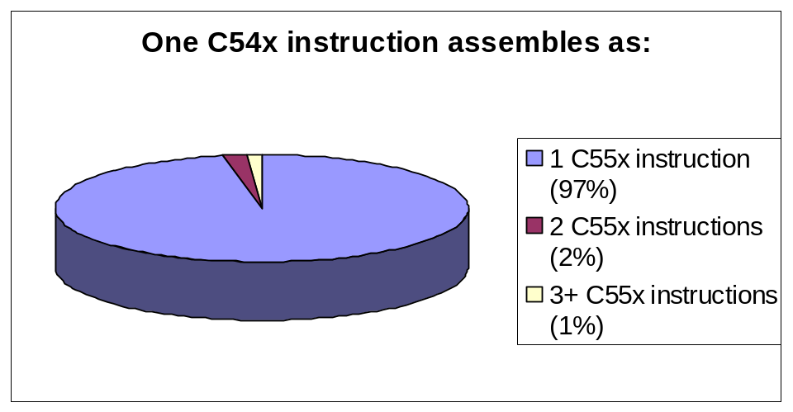
Translating C54x ASM/C Code
C55x assembler accepts all C54x mnemonics (no translation
necessary: C55x instructions are a superset of C54x)
C54x source will execute correctly on C55x (bit exact)
97% of common C54x instructions translate to a
single instruction on C55x:
C code can be re-compiled to a C55x target (no issues)
C55x intrinsics are a superset of C54x
Expect code size to shrink 30% compared to C54x-compiled code
T TO
Technical Training
Organization
Notes:
The numbers shown in the pie chart are based on the MOST COMMONLY USED C54x instructions - based on loads of customer code that were used to gather the benchmarks. If you use strictly the 54x instruction set as is (and NOT look at commonly used instructions), the percentages look worse. This is documented in the Assembly Language Tools Guide in detail.
Also, the documentation shows a range of percentages - I simply picked the middle number and ran with it.

Slide 37
Planned CCS Features
“Dramatic Improvements in Development Time”
Faster
Fast Simulators
Rapid analysis collection enabled by new high-speed simulators
facilitates modeling real-time applications (10-25x faster than today)
Smarter
Advanced Debug Utilities
Provides comprehensive insight into code
for quick and precise problem resolution
Innovative
Intuitive Analysis Tools
Create highly optimized applications to meet unique application needs
T TO
Technical Training
Organization
Notes:
Do we need to explain the difference between Emulators and Simulators
here or in next slide?
Alternate Debug text: Provides comprehensive insight into code for quick
and precise problem resolution
Is this Debug or Tuning?;Powerful view, sort, and evaluation insight into
system execution and exercised code
Easy connection of system traffic to device peripherals Execute at speeds up to 5MHz on a 1GHz PC

Slide 38
CCStudio v2.2/v3.0 - Enhancements
CCS 2.2 Enhancements (1Q03):
Improved usability features such as:
New startup options
Multiple linker files
Large project performance
Toolbar splits
Project management support
Improved symbol loading
DSP/BIOS performance improvements
XDS560 support (drivers for all targets/ISAs)
30 new devices supported
CCS 3.0 Enhancements (C55x-specific):
Advanced Profiling Dashboard - general advice window, goals
window, profile setup, profile view (to view the results)
Compiler Consultant - recommends more efficient coding
Cache Tuner - analyze and tune cache behavior (graph hit/miss)
Power Analyzer - measure energy consumption over a
specified range on target hardware
T TO
Technical Training
Organization

Slide 39
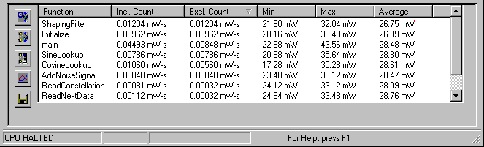
Power-ful Tools for C55x Development
Power Analyzer Plug-in (available NOW)
Visualize power consumption (energy/function) during runtime
Measure single/multiple functions in real-time or non real-time
Save data to a CSV file
Power Data Capture System (available 3Q03)
Use available Tektronix scope/probe or planned PCB from TI
Power Scaling Library (available NOW)
Manages dynamic frequency/voltage scaling (for non-BIOS apps)
DSP/BIOS PWR Module (available 3Q03)
Selectively IDLE parts of device based upon activity
Manages dynamic frequency/voltage scaling (for BIOS apps)
Supports multiple “sleep” states
T TO
Technical Training
Organization

Slide 40
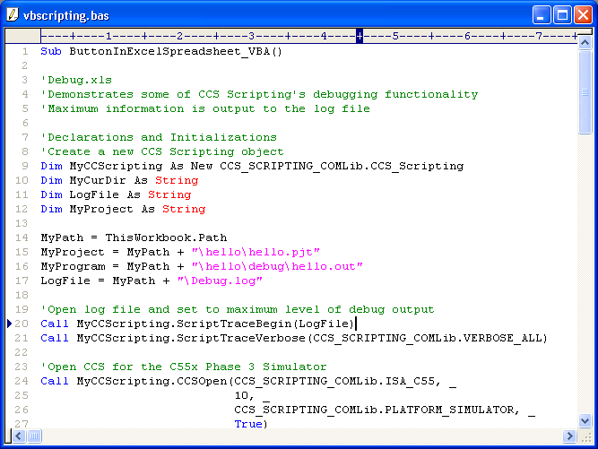
CCS Scripting
Debug using VB Script or Perl
Using CCS Scripting, a simple script can:
  Start CCS
  Load a file
  Read/write memory
  Set/clear breakpoints
  Run, and perform other basic testing functions

Slide 41
Complete TI Hardware Solution
“Everything for your DSP system…”
Power modules
Linear Regs/LDOs
Battery mgmt
Supervisory circuits
USB
1394/Firewire
RS 232/422/485
PCI, Sonet
A/D, D/A, codec
Comm/video DAC/ADC
CCD front ends
Audio converters
Power
Data
Transmission
Codec
Op Amps
ADC
C5510
DSP
LOGIC
DAC
RF
Hi-speed amps
Audio power amps
Comparators
Clocks
Clock distribution
Fanout buffers
T TO
Technical Training
Organization

Slide 42
Recommended Analog for C5510
    TPS62000 High-efficiency 600mA synchronous buck converter with integrated FET
    TPS54310 Switcher with integrated FET for up to 3-A output current.
    TPS79501 Ultra-low noise, High PSRR Low Dropout Regulator
    TPS3110K33 Ultra-low supply current, dual-output Supply Voltage Supervisor
Power
ADS931 Pipelined ADC, very high-performance, low-power, small package
ADS8325 SAR ADC, high performance, very low-power, small package
ADS7844 SAR ADC, multi-channel, very low-power, small package
ADS1605 Delta Sigma ADC, 16-bit (no missing codes), low noise, low power
TSC2302 Highly integrated touch screen controllers with built-in stereo CODEC
TLV320AIC13, TLV320AIC21 16-bit sigma-delta CODEC’s, very low-power
Converters
OPA347 350 KHz, 20 uA: ultra-low power; high-performance, small package
OPA348 1 MHz, 45 uA; ultra-low power; high-performance; small package
OPA349 70KHz, 1ua; ultra-low power; high-performance; small package
Amps
Clks
Visit our mixed-signal website for fanout buffers, zero-delay buffers, synthesizers, etc.
Find all of your mixed-singal needs at: http://analog.ti.com
T TO
Technical Training
Organization
Notes:
PSRR = Power Supply Rejection Ratio (assists in noise-free performance)
SAR = Successive Approximation Register
You can ask at this point - which parts of this “latest and greatest” module was most interesting to you and why?

Slide 43
Summary
Chapter 5
C55x One-Day Workshop
T TO
Technical Training
Organization
Copyright © 2002 Texas Instruments. All rights reserved.

Slide 44
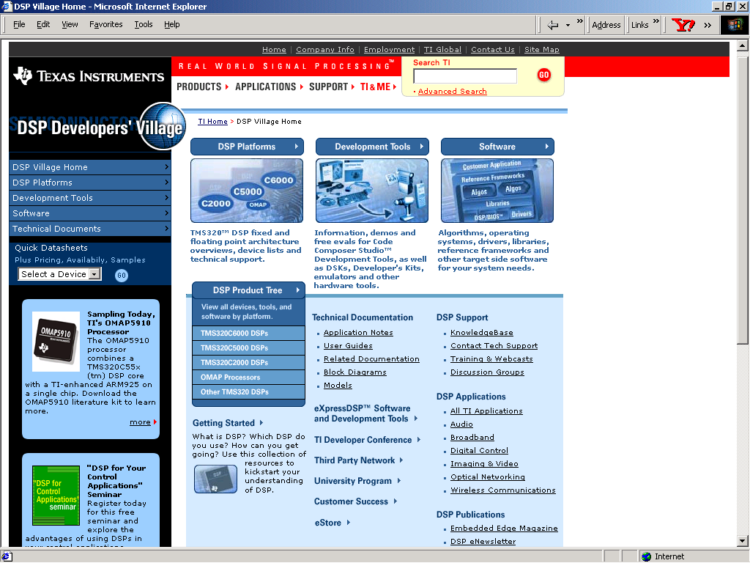
DSP Developer Village
www.dspvillage.com - portal to online DSP design resources
Discovery
Evaluation
Design
Test
Production
T TO
Technical Training
Organization

Slide 45



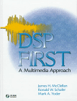
Looking for Literature on DSP?
“A Simple Approach to Digital Signal Processing”
  by Craig Marven and Gillian Ewers;
  ISBN 0-4711-5243-9
“DSP Primer (Primer Series)”
  by C. Britton Rorabaugh;
  ISBN 0-0705-4004-7
“A DSP Primer : With Applications to Digital Audio
and Computer Music”
  by Ken Steiglitz; ISBN 0-8053-1684-1
“DSP First : A Multimedia Approach”
  James H. McClellan, Ronald W. Schafer, Mark A. Yoder;
  ISBN 0-1324-3171-8
T TO
Technical Training
Organization

Slide 46
For More Information . . .
Internet
Website: www.ti.com
dspvillage.com
FTP: ftp://ftp.ti.com/pub/tms320bbs
FAQ: http://www-k.ext.ti.com/sc/technical_support/knowledgebase.htm
⬥ Device information  TI & ME
⬥ Application notes  News and events
⬥ Technical documentation  Training
USA - Product Information Center ( PIC )
Phone: 972-644-5580
Email: sc-infomaster@ti.com
⬥ Information and support for all TI Semiconductor products/tools
⬥ Submit suggestions and errata for tools, silicon and documents
Other Resources
Software Registration/Upgrades: 972-293-5050
Hardware Repair/Upgrades: 281-274-2285
T TO
Technical Training
Organization
Notes:
While I give students my name and email address, I tell them I’m often unavailable (travelling to teach other classes). Therefore, I ask them to use me as a last resort and these options provide a better path of assistance.
If you know the local contacts (TI and or distributor) this is a great time to mention these as well.
Of course, if you’re the local contact and you’re teaching the workshop, you can’t get any better than that!

Slide 47
DSP Workshops Available from TI
Attend another workshop:
4-day C2000 Integration/Opt Workshops
4-day C6000 Integration/Opt Workshops
4-day C5000 Optimization Workshop
4-day DSP/BIOS Workshops
3-day Algo Standard Workshop (xDAIS)
1-day versions of these workshops
2hr 54-55 Migration Tutorial (web-based, FREE)
Sign up at:
http://focus.ti.com/docs/training/traininghomepage.jhtml
T TO
Technical Training
Organization
Notes:
encourage attendees to gain further knowledge through TI workshops,

Slide 48
The TI Advantage
Powerhouse Manufacturing
Continuing to invest in cutting-edge technology
Own our own manufacturing capability
Early access to advanced technology, volume production flexibility, and insurance of order fulfillment
Cost Effective Software Strategy
Multiple hardware platforms on same software platform
Reusable software modules
Reduced R&D and training costs
Faster Time to Market
Reusable and reference software modules
Extensive worldwide support network
Large Breadth of Products (analog and digital), one-stop shop
Beating your competitor to market
T TO
Technical Training
Organization
Notes:
Texas Instruments is continuing to invest in cutting-edge technology even in today’s economy.

Slide 49
Summary and Evaluation
We promised to accomplish the following…
Overview C55x architecture and peripherals
Use Code Composer Studio to edit, build and
debug applications
Analyze and use power reduction techniques
Evaluate methods to maximize performance.
Understand how the Chip Support Library (CSL) is used to set up and program peripherals.
Use BIOS and Real Time Analysis (RTA) tools to build, analyze and debug a DSP system
Run labs/demos using common applications on real hardware (the DSK)
Students: summarize what you learned
How relevant was this topic to your application?
T TO
Technical Training
Organization
Notes:
These are today’s main topics. What you need to give to the students are the following two take-away:
the C5000 is extremely powerful
the C5000 is easy to use
It’s usually a good idea to state the relevancy of each topic to ANY application.Also, at the end of the slide, ask “what is missing?” “what else would you like to cover?”. WRITE DOWN THE RESPONSES (on whiteboard/flipchart) If a general topic surfaces, you may have to address this issue later in the workshop. If some issues are “borderline” or “tangents”, use any method of several to get this info to the student (email later, handle it at a break, after class, during lunch, follow up w/MTS), etc. But, the important thing is to capture this info and use an appropriate method to handle the issue.

Slide 50
Let’s Go Home …
Thank’s for your valuable time today
Please fill out an evaluation and let us know how we could improve this class
  Please go to http://www.tiworkshops.com
If you purchased a DSK:
  Make sure you pack up (or receive) your
  DSK before leaving
  If available, you may keep the earbud headphones and audio patch cable
Workshop lab and solutions files will be available via CDROM or the Internet. Please check with your instructor.
T TO
Technical Training
Organization

Slide 51
Don’t Forget!
Take your workbook, databook(s) and
CD (solutions) with you
Fill out the evaluation form (in pencil) :-)
Large donations to the instructor’s
tip fund are always appreciated.
Thank you for attending.
Have a safe trip home.
T TO
Technical Training
Organization

